Slide 1
Fundamentals of AC Circuits
Module 2: Fundamentals of AC Circuits

Slide 2




overview
$\text{v}\text{(}\text{t}\text{) = }V_{m} \text{sin}\text{(}ω\text{t} \text{−} θ\text{)}$
$f=\frac{1}{T}$
$ω=2πf$
$V_{rms}=\sqrt{\frac{1}{T}\int_{0}^{T}{v^{2}(t) dt}}$
$P_{avg}=\frac{V_{rms}^{2}}{R}$
$I_{rms}=\sqrt{\frac{1}{T}\int_{0}^{T}{i^{2}(t) dt}}$
$P_{avg}=I_{rms}^{2}R$
$V_{rms}=\frac{V_{m}}{\sqrt{2}}$
$I_{rms}=\frac{I_{m}}{\sqrt{2}}$

Slide 3
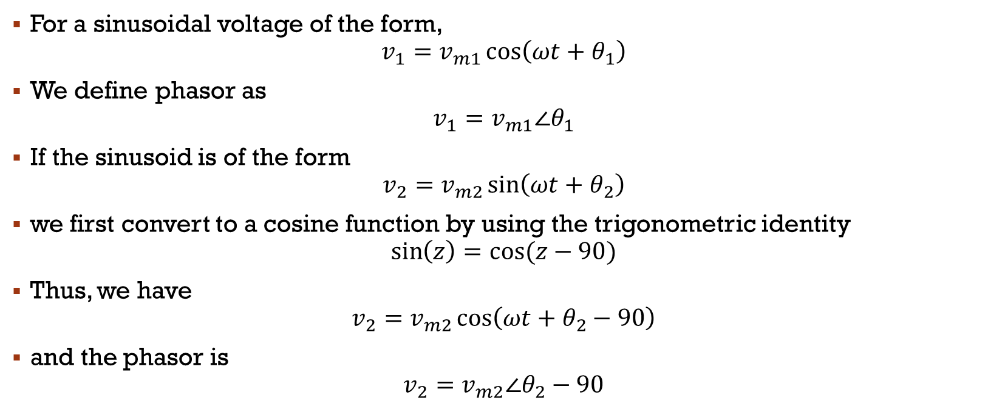
Phasor Definition
For a sinusoidal voltage of the form,
$$v_{1}=v_{m1}\cos\left(ωt+θ_{1}\right)$$
We define phasor as
$$v_{1}=v_{m1}∠θ_{1}$$
If the sinusoid is of the form
$$v_{2}=v_{m2}\sin\left(ωt+θ_{2}\right)$$
we first convert to a cosine function by using the trigonometric identity
$$\sin\left(z\right)=cos⁡(z−90)$$
Thus, we have
$$v_{2}=v_{m2}\cos\left(ωt+θ_{2}−90\right)$$
and the phasor is
$$v_{2}=v_{m2}∠θ_{2}−90$$

Slide 4

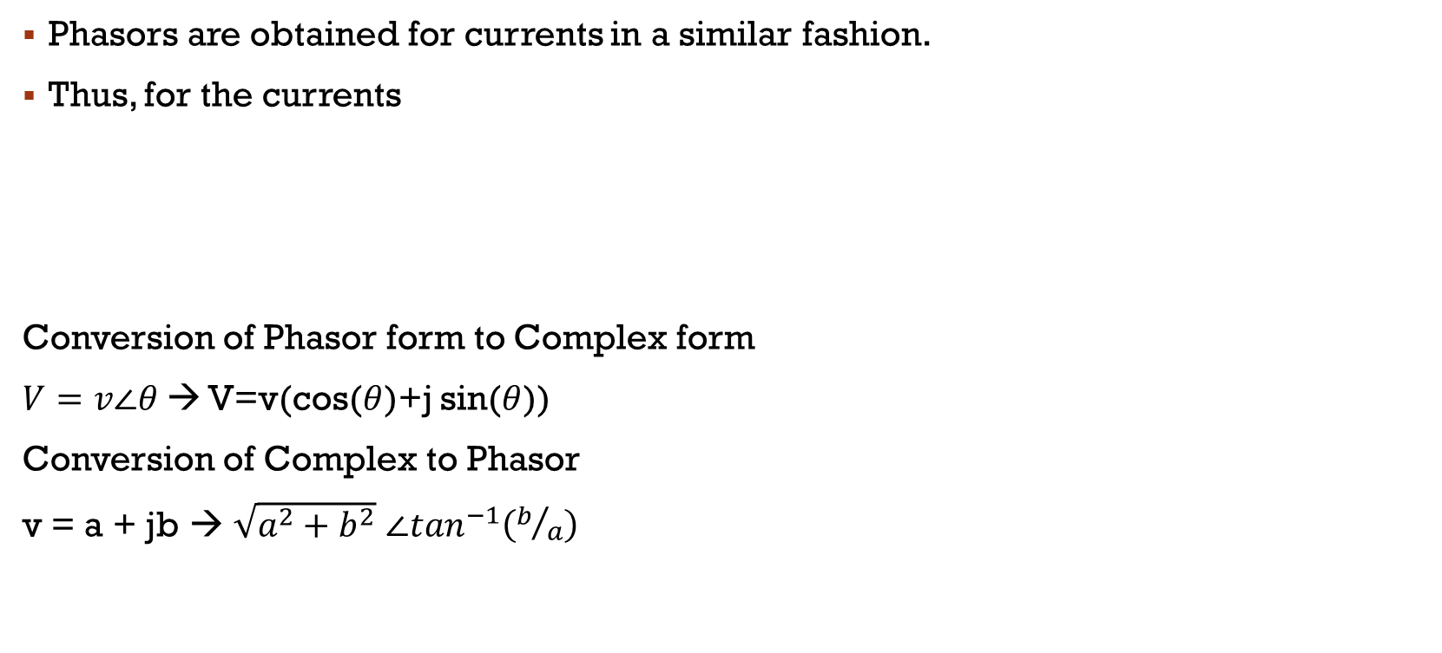
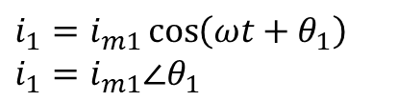
Phasor Definition
Phasors are obtained for currents in a similar fashion.
Thus, for the currents
Conversion of Phasor form to Complex form
$V=v∠θ$ → V=v(cos($θ$)+j sin($θ$))
Conversion of Complex to Phasor
v = a + jb → $\sqrt{a^{2}+b^{2}}$ $∠\tan^{−1}\left(b/a\right)$
$$i_{2}=i_{m2}\sin\left(ωt+θ_{2}\right)$$
$$i_{2}=i_{m2}∠θ_{2}−90$$
$i_{1}=i_{m1}\cos\left(ωt+θ_{1}\right)$
$i_{1}=i_{m1}∠θ_{1}$

Slide 5
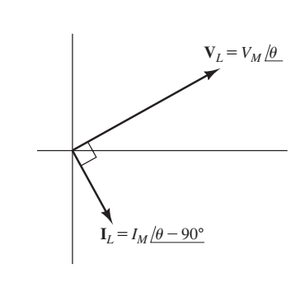
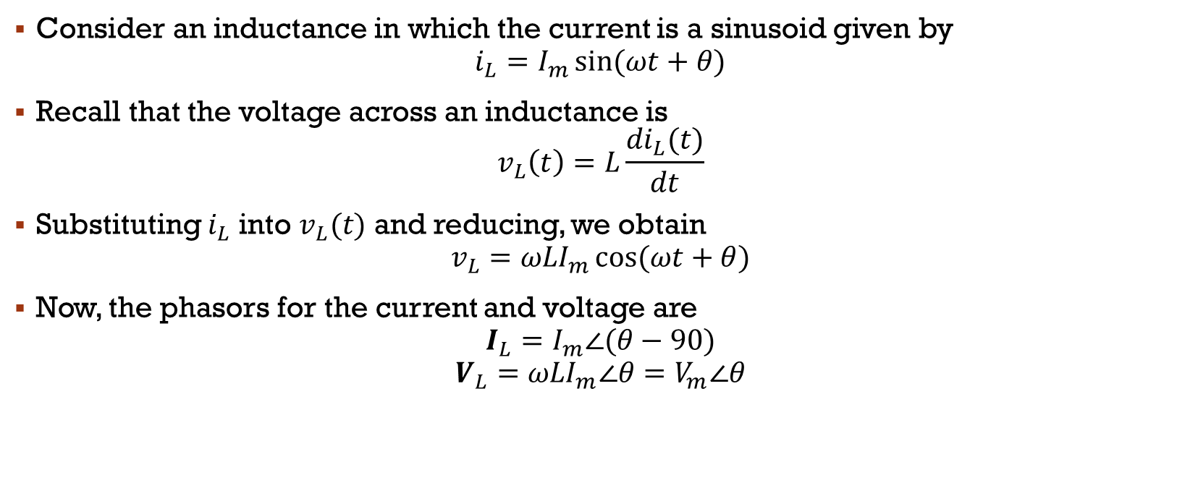
Complex impedances - Inductance
Consider an inductance in which the current is a sinusoid given by
$$i_{L}=I_{m}\sin{(ωt+θ)}$$
Recall that the voltage across an inductance is
$$v_{L}\left(t\right)=L\frac{{di}_{L}(t)}{dt}$$
Substituting $i_{L}$ into $v_{L}(t)$ and reducing, we obtain
$$v_{L}={ωLI}_{m}\cos{(ωt+θ)}$$
Now, the phasors for the current and voltage are
$$I_{L}=I_{m}∠(θ−90)$$
$$V_{L}={ωLI}_{m}∠θ=V_{m}∠θ$$
Current lags voltage by 90° in a pure inductance.

Slide 6

$V_{L}$ can we rewritten as
$$V_{L}={ωLI}_{m}∠θ$$
$$V_{L}={ωL∠90 × I}_{m}∠\left(θ−90\right)$$
$$V_{L}={ωL∠90 × I}_{L}$$
$$V_{L}={jωL × I}_{L}$$
We refer to the term $jωL=ωL∠90$ as the impedance of the inductance and denote it as $Z_{L}$.
$$V_{L}={Z_{L}×I}_{L}$$
Overview
$v_{L}\left(t\right)=L\frac{{di}_{L}(t)}{dt}$
$Z_{L}=jωL$
$V_{L}={Z_{L}×I}_{L}$
Current lags voltage by 90° in a pure inductance.

Slide 7
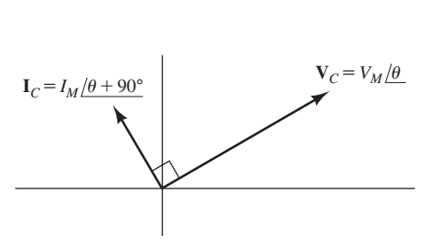
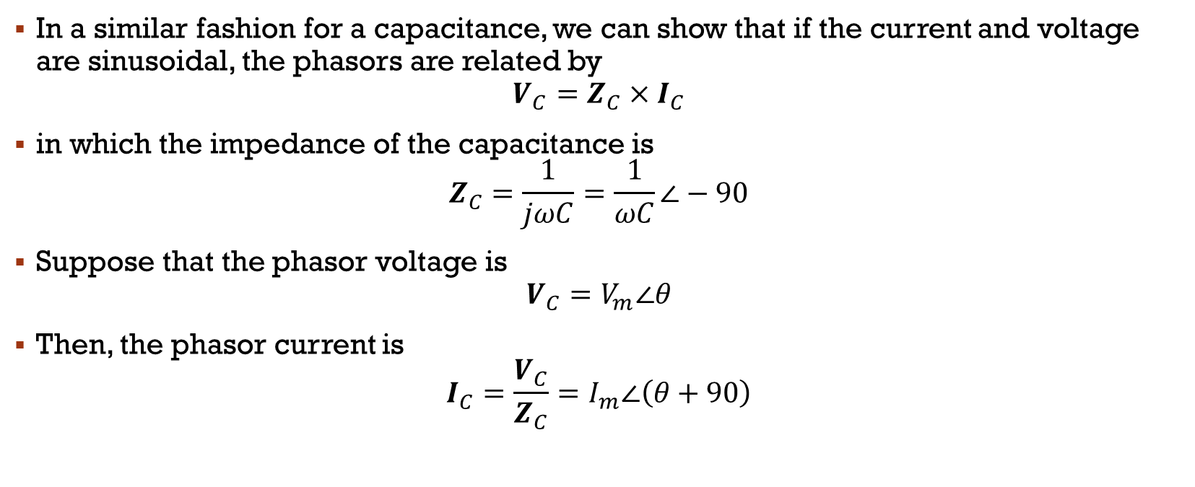
Complex impedances - Capacitance
In a similar fashion for a capacitance, we can show that if the current and voltage are sinusoidal, the phasors are related by
$$V_{C}={Z_{C}×I}_{C}$$
in which the impedance of the capacitance is
$$Z_{C}=\frac{1}{jωC}=\frac{1}{ωC}∠−90$$
Suppose that the phasor voltage is
$$V_{C}=V_{m}∠θ$$
Then, the phasor current is
$$I_{C}=\frac{V_{C}}{Z_{C}}=I_{m}∠\left(θ+90\right)$$
Current leads voltage by 90° in a pure capacitance

Slide 8
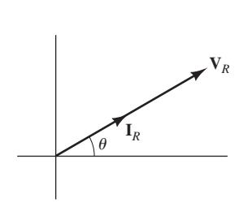

Complex impedances - Resistance
For a resistance, the phasors are related by
$$V_{R}=R I_{R}$$
Because resistance is a real number, the current and voltage are in phase
For a pure resistance, current and voltage are in phase

Slide 9
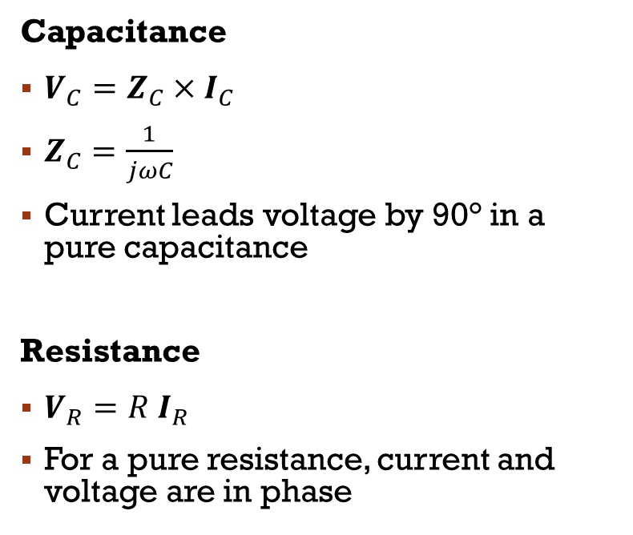
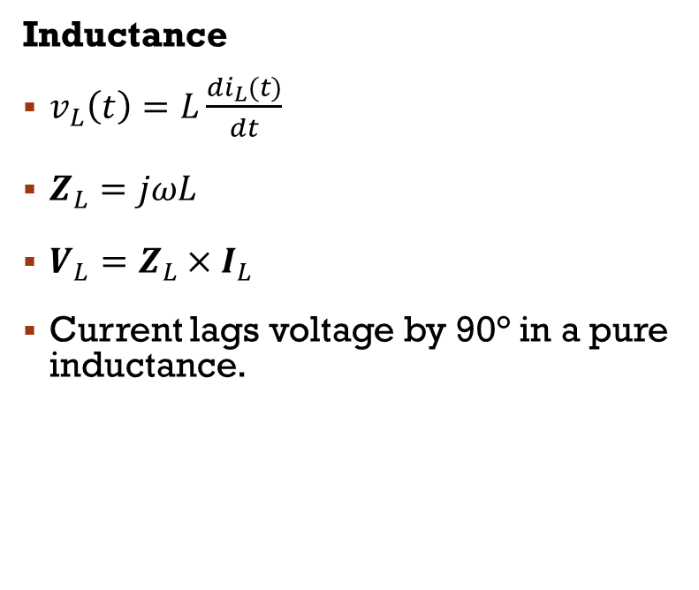
Overview
Inductance
$v_{L}\left(t\right)=L\frac{{di}_{L}(t)}{dt}$
$Z_{L}=jωL$
$V_{L}={Z_{L}×I}_{L}$
Current lags voltage by 90° in a pure inductance.
Capacitance
$V_{C}={Z_{C}×I}_{C}$
$Z_{C}=\frac{1}{jωC}$
Current leads voltage by 90° in a pure capacitance
Resistance
$V_{R}=R I_{R}$
For a pure resistance, current and voltage are in phase

Slide 10
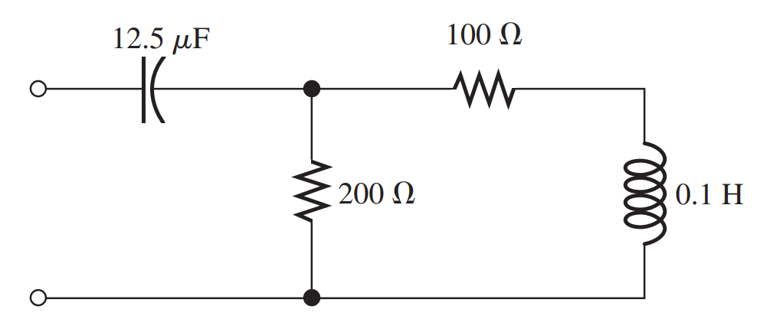

Combining Impedances in Series and Parallel – Ex 1
Determine the complex impedance between terminals shown in Figure for
$ω$ = 1000 rad/s

Slide 11
Ex 2
A voltage vL(t) = 100 cos(200t) is applied to a 0.25-H inductance. (Notice that w = 200.)
a. Find the impedance of the inductance, the phasor current, and the phasor voltage.
b. Draw the phasor diagram.

Slide 12
Ex 3
A voltage vC(t) = 100 cos(200t) is applied to a 100µF capacitance.
a. Find the impedance of the capacitance, the phasor current, and the phasor voltage.
b. Draw the phasor diagram.

Slide 13
Circuit Analysis with Phasors And Complex impedances
Kirchhoff’s Laws
Node-Voltage Analysis
Mesh-Current Analysis

Slide 14
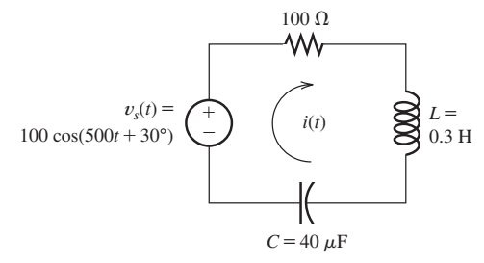
Kirchhoff’s Laws
Steady-State AC Analysis of a Series Circuit
Find the steady-state current for the circuit shown in Figure. Also, find the phasor voltage across each element

